Slide 1
Soda Pop Head Presented by Jacob Wolf District ED Program Facilitator
September 29, 2017

Slide 2
"The goal of resolving conflict in a relationship is not victory or defeat. It's reaching understanding and letting go of our need to be right. "

Slide 3
Why has there been such a big change in recent years?
Increased stress on families and students
Financial
Non-stop stimulus
Busy schedules
Academic demands
Mental Health System Inadequacies
Long wait periods for services
Insurance funding for therapy and medications
Issues with navigating the system

Slide 4
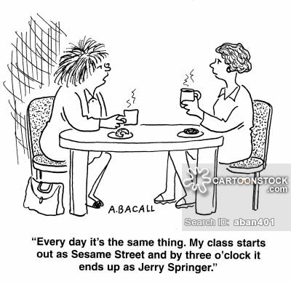
In the meantime we have students in crisis on a daily basis. What can we do to help them de-escalate?

Slide 5
De-Escalation Myth:
The best staff in your building are able to quickly help a student de-escalate from a crisis
FALSE

Slide 6
The best staff in your building are able to implementation strategies, techniques, and structure that lessen the number of times a student escalates in the first place.

Slide 8
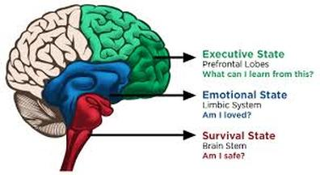
Know the Brain State

Slide 9
Think of a student who has displayed significant behavioral concerns in the past 1) What did they look like when they were calm? 2) What did they look like when they were in crisis?

Slide 10
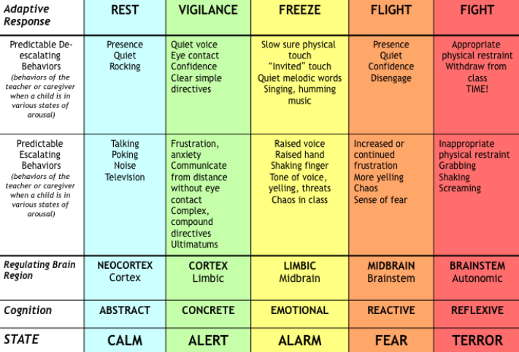

Slide 11
On your blank sheet write down a few things that staff might do to escalate the situation with the student you chose

Slide 12
De-Escalation Strategies
As we go through these strategies, techniques, and tips record some that you think might assist the student you chose.

Slide 13
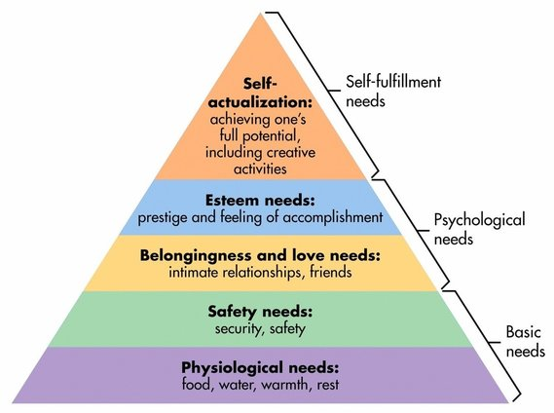
Basic Needs

Slide 14
Potential Impact on Student Basic Needs
Breakfast, Lunch, and Dinner
Snacks during the day
Clean home
Water and electricity
Warmth in the fall and winter
Sleep patterns
Safety and security at home and at school
Loving relationships

Slide 15
Basic Needs???

Slide 16
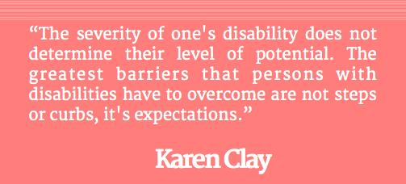
Behavioral Expectations & Consistency

Slide 18
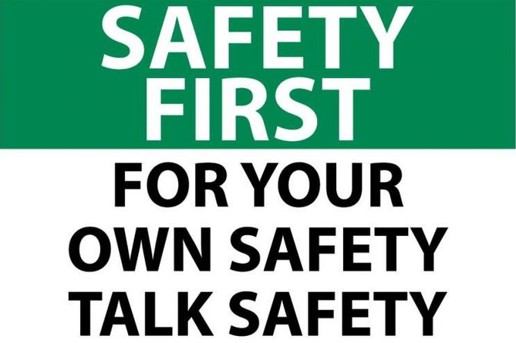
Consistency in Staff Response
Staff who are inconsistent in their responses and interactions with students have a feeling of being unsafe and unpredictable to the student
School crisis teams must be aware of each others’ actions:
It would be better to check out before saying or doing something that would damage the safe relationship with the student

Slide 19
Community & Relationship Building
Rarely can someone unfamiliar with a student be the one to help them calm down
Crisis team staff members must take the time to develop a relationship with the student
See http://behaviorideas.weebly.com/de-escalation-strategies.html (Community Building Videos)

Slide 20
Community & Relationship Building
Relationship building might include:
Personal connection activities
Check in/Check out
Helper jobs
PBIS reward activities with a staff member (feed fish, do hair)
Provide clean clothes when needed
Doing an activity with the student and another student
I Love You Rituals

Slide 21
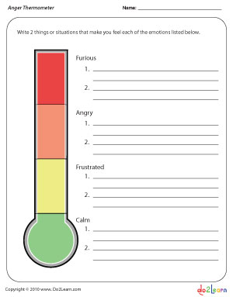
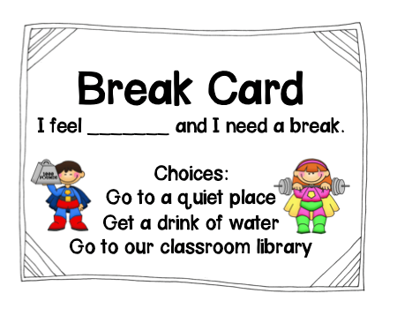
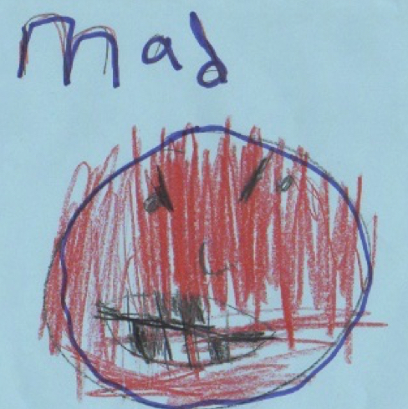
Knowing the Triggers
Effective staff members are aware of potential triggers that may escalate the situation
See Trigger Inventories on http://behaviorideas.weebly.com/de-escalation-strategies.html

Slide 22
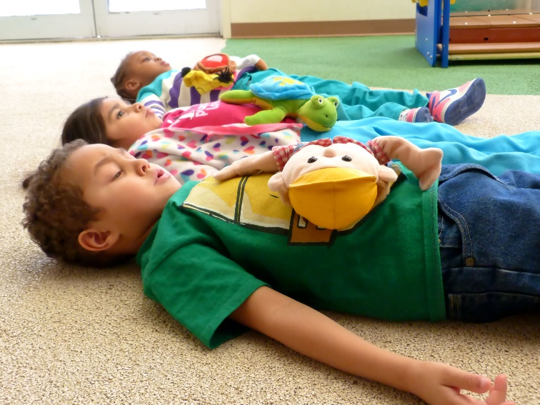
Mindfulness
Students are arriving at school far more stressed than in the past. School staff must help students acclimate to the school environment with calming activities.
Mindfulness Activities:
Mirroring with a partner
Calming Music
Soothing Lighting
Modeling and Self-Talk through Calming Activities
Yoga or Deep Breathing Exercises

Slide 23
Change of Environment (and staff)
Students often associate the staff that were present at the time of escalation as a present threat to their safety.
Although it is difficult for staff to swallow their pride, it may be beneficial to have the student come to a different setting and/or interact with staff who were not present at the time of the incident.
Once the student is calm and is ready to process the incident then the student can be returned to the original setting and staff to process.

Slide 24
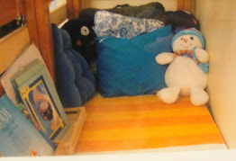
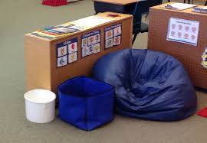
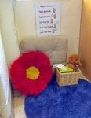
Safe Spots
Students should know where they can go when they feel frustrated

Slide 25
Silence
Too often adults try to talk too much when students just want silence to calm down
We must learn when students want silence and when students are seeking assistance

Slide 26
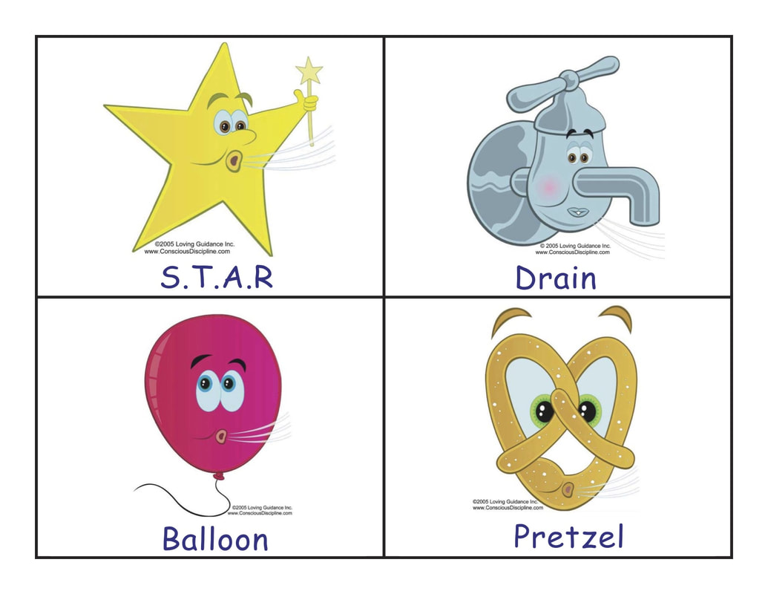
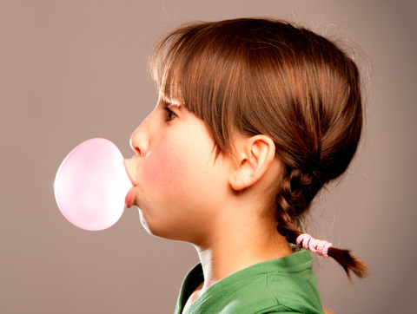
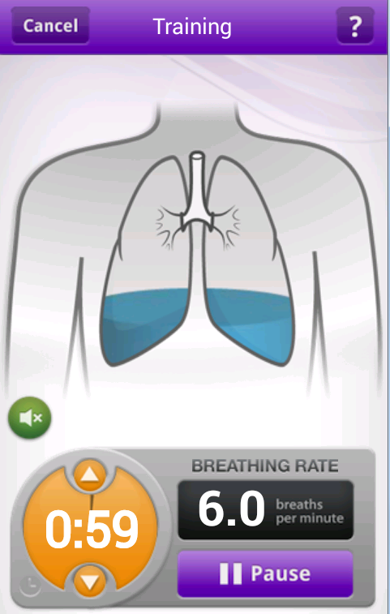
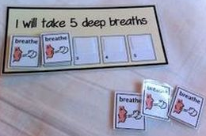
Breathing Strategies
My Calm Beat App

Slide 27
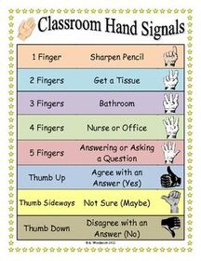
Secret Signals

Slide 28
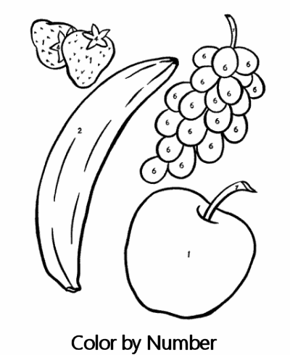
De-Escalation Activities
Coloring or Drawing Activities:
Coloring is a strong therapeutic activity that can reduce stress in addition to providing insightful information to school staff regarding the student’s emotional well-being. If you don’t have coloring pages, then blank paper and pencils or crayons work great.

Slide 29
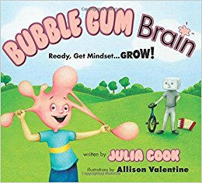
De-Escalation Activities
Read-Aloud or Silent Reading:
If you have the time to read a book, then this can be a productive use of school time and can also help establish a stronger relationship with the student. It is best use of the time to find books that can be related back to social emotional learning needs.

Slide 30
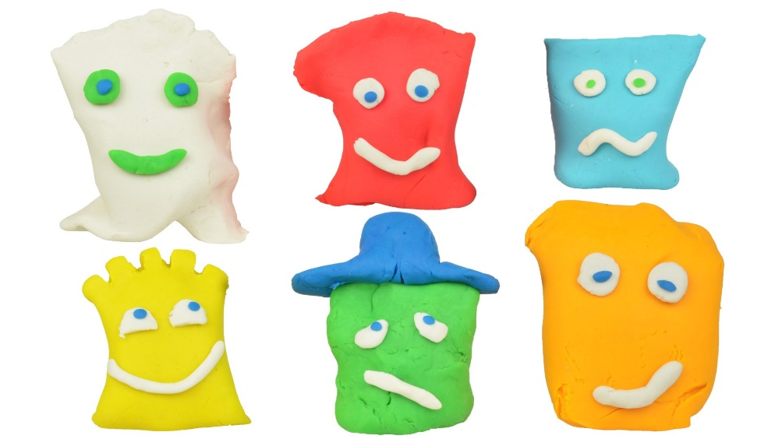
De-Escalation Activities
Play-doh/Sculpting:
Using Play-doh or modeling clay can help students to de-escalate by allowing them to become preoccupied by a separate activity. It also provide physical input and pressure which can relieve stress. You can have a stack of cards with things that the student can try to make.

Slide 31
De-Escalation Activities
Mirror Activities:
Having students learn to recognize how their own body feels can help the student recognize their emotions over time.

Slide 32
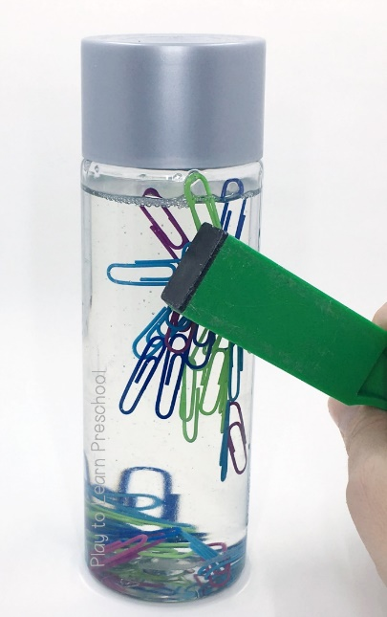
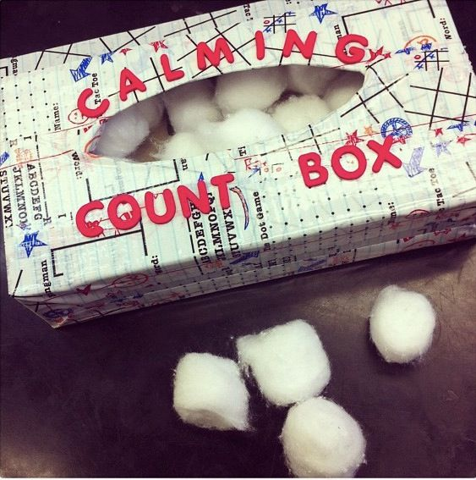
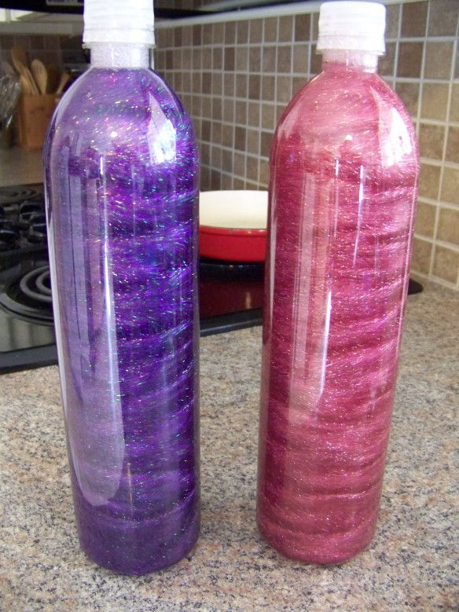
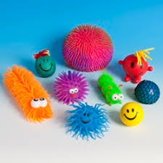
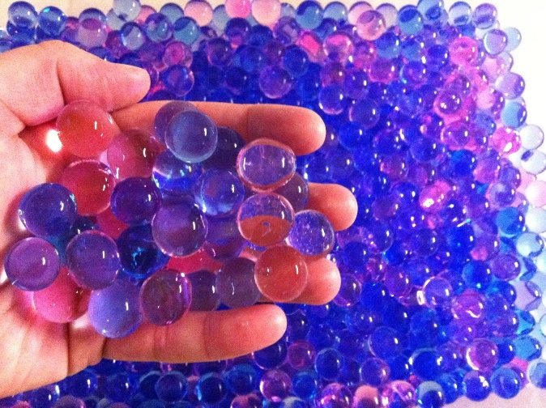
De-Escalation Activities
Handheld Fidgets/Sensory Items:
Fidgets can be a great way to help students get their mind off the events of the escalation. It is important that staff process with students about the incident but the student must be able to calm first.

Slide 33
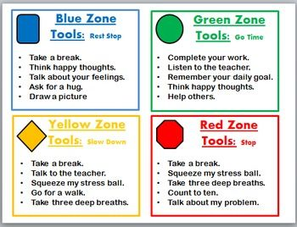
Calm Room
Considerations :
Soft Lighting
Place for students to seclude themselves
Soft Blanket/stuffed animal
Neutral colors
Calming music
Calming manipulatives (consider calm boxes)
Visuals for emotional regulation teaching

Slide 34
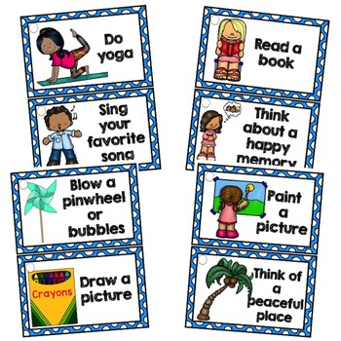
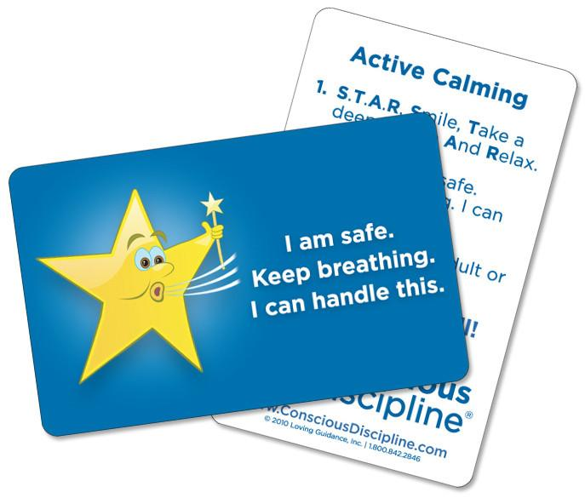
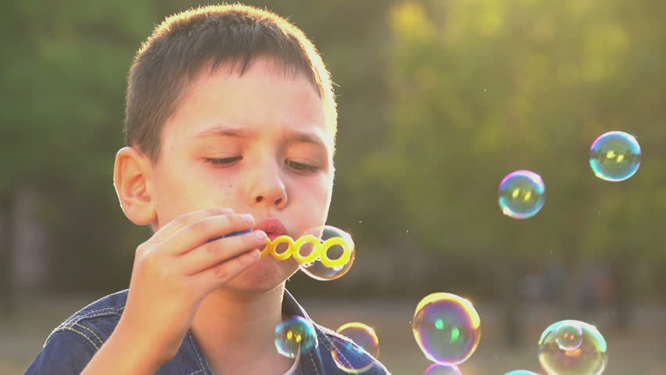
Calm Kits
Student create their own calm kits
Might include:
Favorite book
Play-doh or Theraputty
Feeling Buddy
Bubbles or windmill for breathing
Breathing card/visual
Calming fidget
Break idea cards

Slide 35
Calm Room
Need to be explicit about the expectations and procedures for calm room use
Not a play room
Students still need to be accountable for the work missed
Not a place to get treats and prizes
Keep data on student usage to determine behavioral trends
Need to have a trusted, caring adult

Slide 36
What about the consequence?

Slide 37
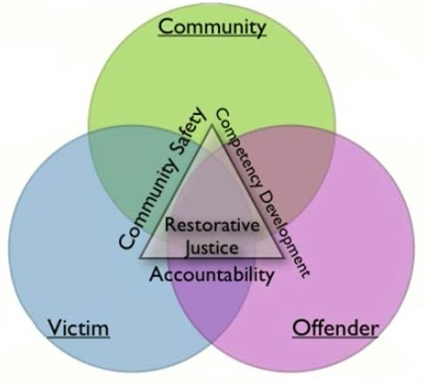
Restorative Justice
Following a behavioral incident, one of the first questions is typically: What is the consequence going to be???
The use of restorative justice can be transformative in addressing the needs of all parties

Slide 38
Restorative Justice

Slide 39
Examples of Consequences
Behavior | Consequence
Destroys or damages property | Clean up the area Given community service within the school Help the custodian for specified amount of time Prepare a presentation for younger students about respect for the community and personal property Apology note to peers or teacher
Aggression toward others | Apology note Prepare a presentation for others about what a safe body looks like Write a short story about a having a safe body Peer mediation session Service toward the victim of the aggression
Not going to class | Complete the missing work Assigned work time for time that was missed Alternate work task to make up for the missed time
Stealing items | Service toward the victim (e.g., steals PE equipment so performs service in the PE area) Teach others about the importance of trust and integrity (e.g., Kahoot)

Slide 40
Resources:
https://consciousdiscipline.com/
https://www.samhsa.gov/topics
http://behaviorideas.weebly.com/
http://traumaessentials.weebly.com/
http://restorativejustice.org/#sthash.34FHRfxw.dpbs

Slide 41
Questions???

