Slide 1
Using Visuals to Support Routines and Transitions
Mendy Ruthrauff and Shari Hardinger
SMSD Autism Behavior Specialists

Slide 2
What are Visual Supports and How Do We Use Them?
Environmental Cues
furniture arrangement
location of objects
signs, signals, labels, menus
Traditional Tools for Organization and Giving Information
calendars, daily planners
schedules, TV guides, movie listings
maps
written instructions and directions

Slide 3
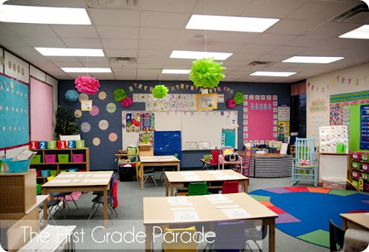

Slide 4
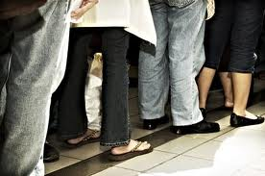

Slide 5
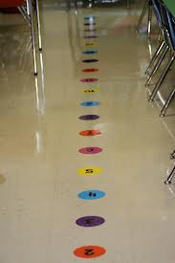

Slide 7
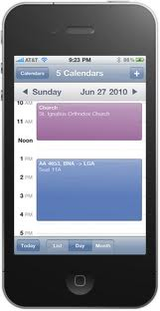

Slide 8
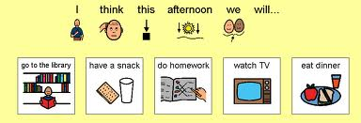

Slide 9
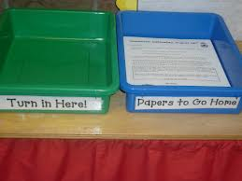

Slide 10
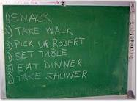

Slide 11
Why
National Standards Report 2009– Established Treatments
Modeling
Naturalistic teaching
Schedules
Story based interventions
Self managements
Checklists
Visual prompts

Slide 12
Why Use Visual Supports
Some individuals with developmental delays experience difficulty attending to, modulating, or understanding auditory stimuli
Some individuals with pervasive developmental disorders demonstrate difficulty attending to the communication message while blocking out background noises
Notes:
Difficulty especially if behavior is escalated when a child is in crisis, limit/stop your auditory cueing – try visuals (Brayden wanting Mimi – Shari draws a stick figure of Mimi)
Use an object from the room as a visual cue for transitioning

Slide 13
Make a digger
Notes:
Get into groups (line up according to birth month – NO TALKING)
Shari gives verbal directions on how to make a digger.
1st attempt “Make a digger”
2nd attempt – Shari gives more discreet directions (all verbal)
Ask – how are you doing so far? (not successful)

Slide 14
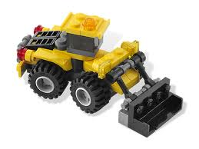
Make a digger
Notes:
3rd attempt – show picture “make a digger”
Ask – how did this work for you?
4th attempt – step by step verbal directions as well as individual directions ****talk about difficulty when a kid is supposed to see visuals and we won’t stop talking.
Ask - How did that work for you?
5th attempt – promote most independence
Ask – how did that work for you?
Discuss pros and cons

Slide 15
Common Misconceptions
“He knows what to do, we do it every day”
“He understands everything I say”
“He is too high for that”
“He won’t use them”
“He’s choosing not to do it”
The use of visual supports is not determined by the individual’s ability to talk, read or listen. They are valuable to both verbal and non-verbal students.
Notes:
Mendy came up with this title!!
Give example of talking mendy’s mother through making a genius appt
Shari’s internet email story

Slide 16
Benefits in Implementing Visuals Supports
Provides an understanding of the environment and expectations
Increases the opportunities for communicating
Elicits initiation of an interaction
Increases the ability to self-manage behaviors
Provides structure to allow the understanding & acceptance of change

Slide 17
Benefits in Implementing Visuals Supports
Clarifies verbal information
Helps establish and maintain attention
Presents information in a form that can be quickly and easily interpreted
Supports transitions between activities or locations
Provides a concrete method of teaching concepts such as time, sequences, and cause/effect

Slide 18
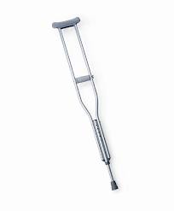
Promotes independence
+
=
Independence
+
=
Dependence
Notes:
This is what we are here for! Shari to put in visual equation
Picture of a kid + visual = independence
Picture of a kid + verbal = dependence

Slide 19
Determining the Level of Visual Representation
Objects
Representational objects
Photos
Color drawings (including picture icons)
Black and white line drawing
Words

Slide 20
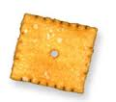
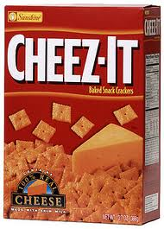
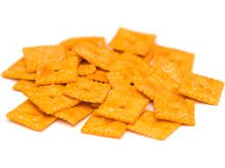
Snack
Notes:
Discuss Carol’s new plan for

Slide 21
Types of Visual Supports
Visual Schedules
Choices
Checklist and Organizers
Activity Completion Signals
Social Stories
Modeling
Additional Visual Management Tools
Notes:
SHOW EXAMPLES

Slide 22
Visual Schedules
Must be used consistently
Student may take an active role in setting the schedule when appropriate
Should be used prior to transitions for example, changes in tasks, locations, and people
As the student finishes each task on the schedule have them indicate completion

Slide 23
Visual Schedules
Some students may require use of their schedule in all settings
Do not terminate the use of this intervention
Notes:
Just adjust it

Slide 24
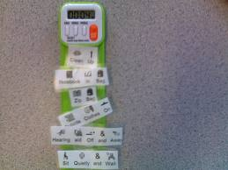

Slide 25
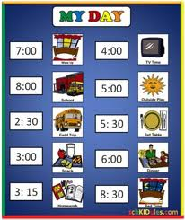

Slide 26
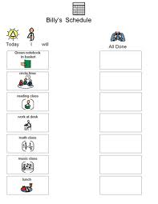

Slide 27
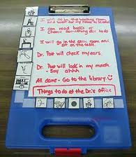

Slide 28
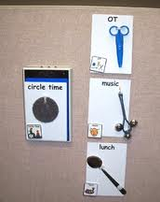

Slide 29
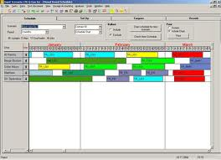

Slide 30
Choices
Avoid power struggles by allowing students to make choices when appropriate.
Offer in a visual format
Allows for flexibility as well as some degree of control for the student.

Slide 31
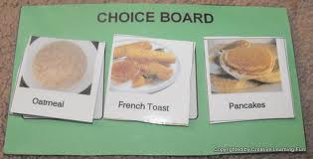

Slide 32
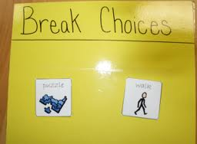
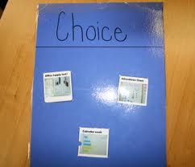

Slide 33
Checklists and Organizers
Some individuals are capable of completing parts of a task, but lack the ability to organizational skills needed to complete the entire activity
Used to give added structure to a specific activity or lesson
Breakdown of the steps necessary to complete an activity

Slide 34
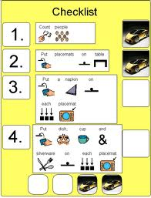

Slide 35
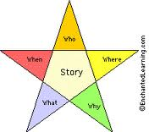

Slide 36
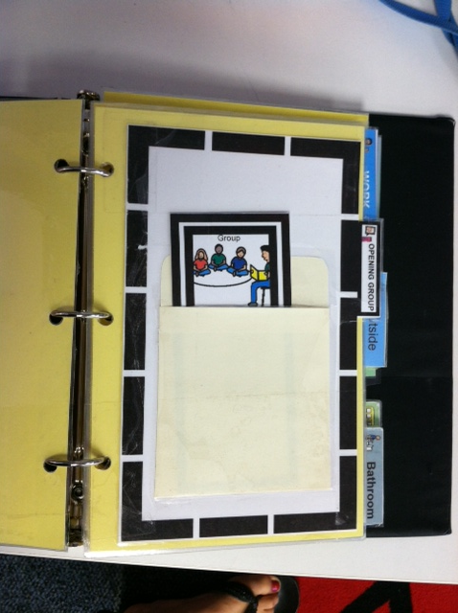

Slide 39
Activity Completion Signals
Many students with autism have limited understanding to time concepts
knowing how long an activity will last
knowing when they will be told to stop an activity
These signals facilitate transition by indicating that the task is finished

Slide 40
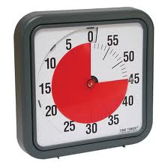

Slide 42
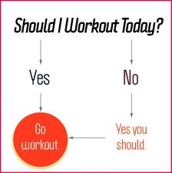
Notes:
Sometimes the completion signal is just the completion of the project.

Slide 43
Social Stories
Teaches appropriate behaviors through the format of a story, often using the child as the main character.
Need to be concisely written and not too “busy” with pictures or words

Slide 44
Don’t Be a Space Invader
Sometimes I want to touch people with my hands.
Sometimes I want to hug people. This may make them uncomfortable. It is important that I keep an arm’s length distance between myself and others.

Slide 45
Most people touch and hug their friends and family at times.
It is okay to hug my family.

Slide 46
It is not okay to hug kids at school. When I do this, I am invading their space.
If I want to touch a friend at school, I will shake his hand.

Slide 47
I will hold out my hand and say, “Shake”.
Some of the times the friend will shake my hand.

Slide 48
Some of the times the friend will not want to shake my hand. That is okay.
When I go home I can hug my family.

Slide 49
My parents and teachers will be proud of me for not being a space invader and for keeping an arm’s length away from other students.
They will be proud of me for shaking hands at school.
My parents will be happy to hug me.

Slide 50
Modeling
Live model
Peer model
Adult model
Video model
Video model
Video self model

Slide 51
Strategy Cards
provides needed information regarding behavior expectations and consequences
makes directions clear and concise
increases awareness and understanding of social situations

Slide 52
When the Work is Hard I use my ruby thoughts
Instead of becoming frustrated when a class assignment is hard.
I will:
Raise my hand for help and wait calmly
Work on the parts of the assignment that I do know
Think about my ruby thoughts that make me feel calm
Think positive thoughts such as:
“ I am smart”
“ I am not the only one who thinks the assignment is hard”
“ With just a little bit of help, I know I can do the assignment”

Slide 53
Power Cards
Visual aid that uses child’s special interests or hero to teach
Presents student with strategy used by a hero to solve a problem
Capitalizes on the “relationship” between the child and the hero or role model
Gagnon, 2001

Slide 55
Visual Behavior Supports
Visual Reinforcement Systems
anything that increases a behavior upon which it is contingent
must be immediate and consistent
deliver at appropriate rate

